Slide 1
Exploration of capabilities and applications of recent specialized hardware components in modern GPUs
Andrei-Viorel Grigorescu
High Performance Computing & Big Data Analysis
Department of Computer Science
Babeș-Bolyai University, Cluj-Napoca
Notes:
Welcome to my presentation on the subject of recent specialized hardware components in modern GPUs
We will see that these refer to

Slide 2
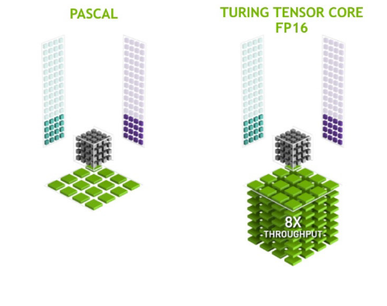
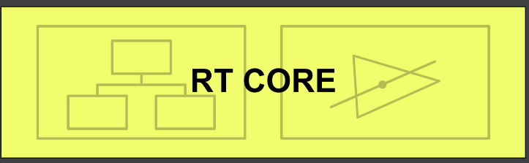
NVIDIA Turing Architecture
Tensor Cores
RT Cores (Real-Time Ray Tracing)
Figures from NVIDIA, NVIDIA Turing GPU Architecture [Whitepaper], WP-09183-001_v01
Notes:
... Tensor cores and RT cores
Introduced in 2018, NVIDIA’s Turing GPU architecture comes with a series of new hardware, including tensor cores and RT cores, marking the first time such components were made available to a broader segment of consumers. Ever since, other GPU vendors have started adding similar components to their devices.
Tensor cores have been more popular in general purpose GPU programming because of the acceleration provided to tensor operations, and have been successfully used in accelerating matrix multiplication and addition with extensive applications in domains like artificial intelligence. While approached in the paper corresponding to this presentation, tensor cores are represented by a small instruction set, and attention is instead drawn to RT Cores, which were mostly marketed for their capability of enabling what NVIDIA calls real-time ray tracing in 3D applications such as games or virtual reality.

Slide 3

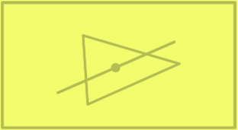
RT Cores
Mostly makes sense in a scene graph (3D virtual world)
These are specialized hardware units, independent of graphics and compute tasks
Supported operations, in tandem with their driver:
Navigate acceleration structures such as bounding volume hierarchies (BVH) autonomously for speedup of ray tracing
Solve for intersections between a ray and a triangle/quad (geometric primitive) or with a bounding box (or rarer – linear swept spheres)
Notes:
Raytracing seems to only makes sense if you have 3D objects and a scene graph to trace rays in.
These ray tracing cores are meant to offload the costly navigation operations from compute cores, where they used to be done before
All it takes for a raytracing core to trace a ray is to emit the command with the ray’s origin, direction and the scene to traverse

Slide 4
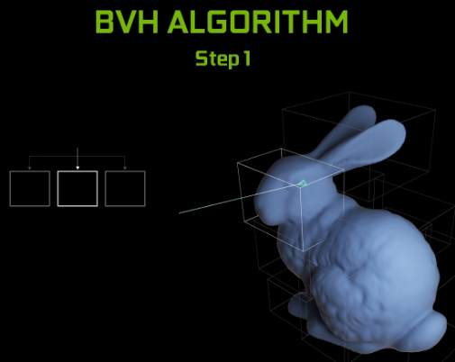
Bounding Volume Hierarchy (BVH) Traversal
Ray tracing complexity scales linearly with number of triangles
Acceleration structures were introduced to reduce this complexity
Example of acceleration structures are bounding volume hierarchies
These work by reducing ray-triangle intersections with ray-bounding box intersections and excluding rest of triangles
Figures from NVIDIA, NVIDIA Turing GPU Architecture [Whitepaper], WP-09183-001_v01
Notes:
As modern applications use models with a large number of triangles, testing intersection of a ray with each triangle is not a feasible solution for ray tracing
Bounding volume hierarchies are an example of acceleration structure that reduce the complexity of this task
Prior to the introduction of such hardware components, traversal of such a structure would be done using compute shaders, named kernels, on the GPU
Now, RT cores are capable of navigating such structures on their own so that they may find intersections.
This is done using two levels of acceleration structures

Slide 5
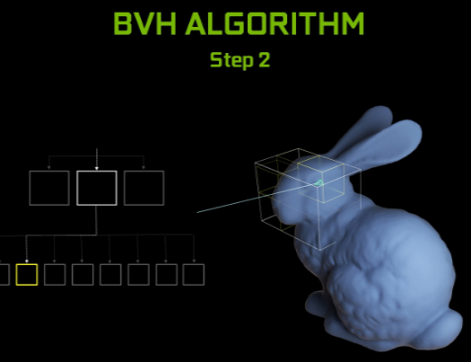
Bounding Volume Hierarchy (BVH) Traversal
Ray tracing complexity scales linearly with number of triangles
Acceleration structures were introduced to reduce this complexity
Example of acceleration structures are bounding volume hierarchies
These work by reducing ray-triangle intersections with ray-bounding box intersections and excluding rest of triangles
Figures from NVIDIA, NVIDIA Turing GPU Architecture [Whitepaper], WP-09183-001_v01
Notes:
As modern applications use models with a large number of triangles, testing intersection of a ray with each triangle is not a feasible solution for ray tracing
Bounding volume hierarchies are an example of acceleration structure that reduce the complexity of this task
Prior to the introduction of such hardware components, traversal of such a structure would be done using compute shaders, named kernels, on the GPU
Now, RT cores are capable of navigating such structures on their own so that they may find intersections.
This is done using two levels of acceleration structures

Slide 6
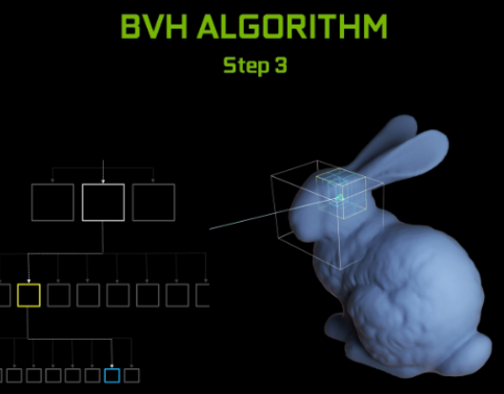
Bounding Volume Hierarchy (BVH) Traversal
Ray tracing complexity scales linearly with number of triangles
Acceleration structures were introduced to reduce this complexity
Example of acceleration structures are bounding volume hierarchies
These work by reducing ray-triangle intersections with ray-bounding box intersections and excluding rest of triangles
Figures from NVIDIA, NVIDIA Turing GPU Architecture [Whitepaper], WP-09183-001_v01
Notes:
As modern applications use models with a large number of triangles, testing intersection of a ray with each triangle is not a feasible solution for ray tracing
Bounding volume hierarchies are an example of acceleration structure that reduce the complexity of this task
Prior to the introduction of such hardware components, traversal of such a structure would be done using compute shaders, named kernels, on the GPU
Now, RT cores are capable of navigating such structures on their own so that they may find intersections.
This is done using two levels of acceleration structures

Slide 7
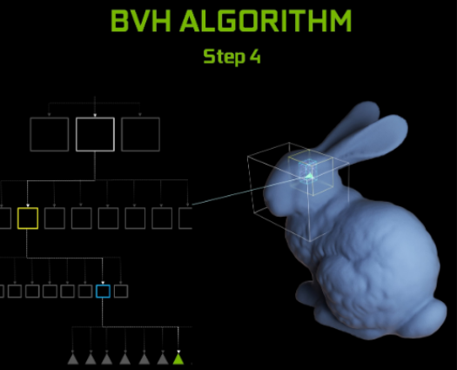
Bounding Volume Hierarchy (BVH) Traversal
Ray tracing complexity scales linearly with number of triangles
Acceleration structures were introduced to reduce this complexity
Example of acceleration structures are bounding volume hierarchies
These work by reducing ray-triangle intersections with ray-bounding box intersections and excluding rest of triangles
Figures from NVIDIA, NVIDIA Turing GPU Architecture [Whitepaper], WP-09183-001_v01
Notes:
As modern applications use models with a large number of triangles, testing intersection of a ray with each triangle is not a feasible solution for ray tracing
Bounding volume hierarchies are an example of acceleration structure that reduce the complexity of this task
Prior to the introduction of such hardware components, traversal of such a structure would be done using compute shaders, named kernels, on the GPU
Now, RT cores are capable of navigating such structures on their own so that they may find intersections.

Slide 8
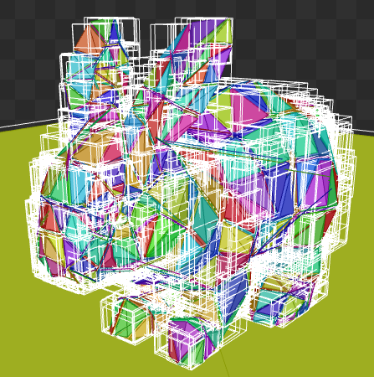
Acceleration structures – Bottom level (BLAS)
Defined per model (but not per instance)
Surrounds and then groups triangles or quads with bounding boxes
For simplification, the boxes can be axis aligned (AABB)
Notes:
Bottom level acceleration structures represent unique instances of a model
Uses a bounding volume tree structure where a model is decomposed in progressively smaller bounding boxes until individual triangles can be determined
For simple computation, bounding boxes are axis aligned

Slide 9
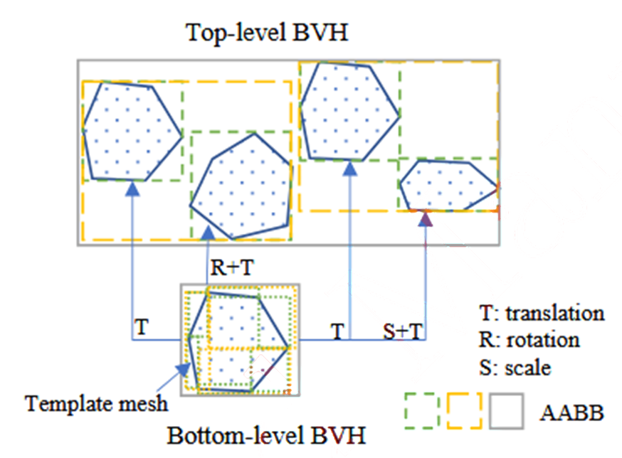
Acceleration structures – Top level (TLAS)
Contains BLAS elements, these may be repeated
Each BLAS entry in TLAS has its own transform: translation, rotation, scale; in world space
Transform does not modify BLAS
Corresponds to the whole scene graph (virtual world)
TLAS is the entry point for ray tracing operations (=> required)
Figure from: S. Zhao and J. Zhao, "Revolutionizing granular matter simulations by high-performance ray tracing discrete element method for arbitrarily-shaped particles," Computer Methods in Applied Mechanics and Engineering, vol. 416, no. 116370, 2023.
Notes:
Top level acceleration structures contain BLAS elements, paired with their transform.
Even as the TLAS instance transform modifies, it has no impact upon the BLAS representation
Thus TLAS entries construct the scene graph, and the TLAS represents an entry point for ray tracing operations

Slide 10

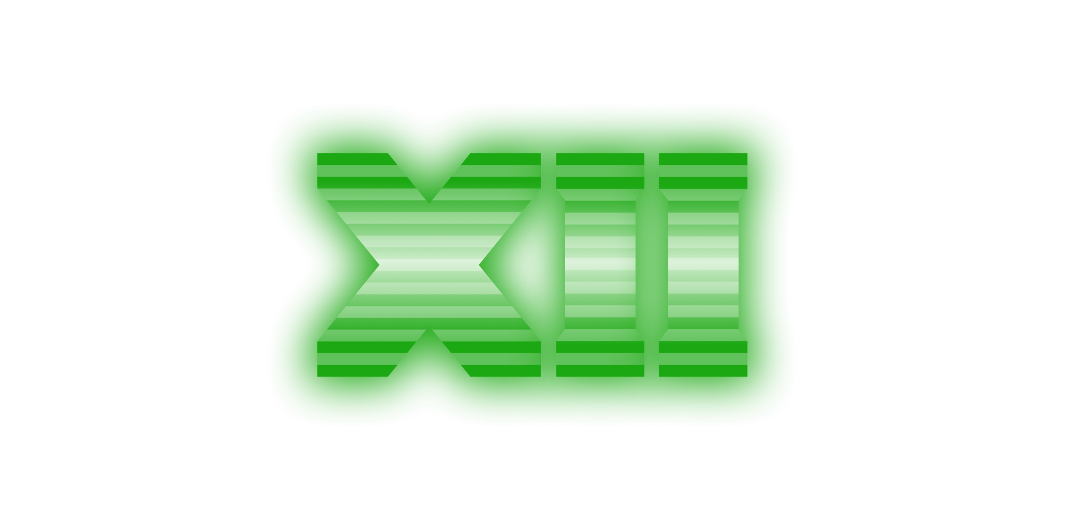

How can we use RT cores?
NVIDIA OptiX – ray tracing engine from NVIDIA, can interoperate with CUDA (but RT cores are not directly accessible from CUDA)
Vulkan – as a graphics device API, Vulkan supports everything from graphics pipelines, to compute pipelines, and offers a separate ray tracing pipeline extension regardless of GPU vendor
DirectX 12 (DXR) – more likely to be found in games, not approached in this research
Notes:
So what options do we have for using these features?
NVIDIA’s CUDA offers access to tensor cores through warp-matrix multiplication and addition instruction set, but to access the RT cores, it must interoperate with OptiX, NVIDIA’s ray tracing engine, which offers programmable shaders still.
Vulkan’s API is an open-standard, cross-platform solution for low-level GPU graphics and compute programming. It has included extensions for cooperative matrix operations that use tensor cores and offers an entire dedicated pipeline for ray tracing operations.
Open computing language or OpenCL does not officially support either, but through PTX, assembly-like instructions for GPU, tensor core functions can be accessed.
Finally, DirectX twelve also supports ray tracing, but is more likely to be found in games and is thus not approached

Slide 11
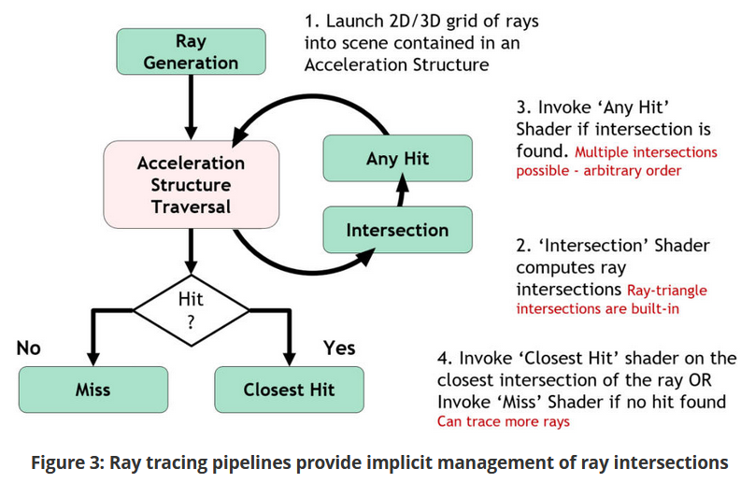
Vulkan – Ray Tracing Pipeline (2020)
Standard negotiated with the top 3 desktop GPU vendors: NVIDIA, AMD, Intel
More vendors added support
Pipeline separate from graphics or compute
Operates on acceleration structures and thus requires them
Notes:
Vulkan’s ray tracing extensions are based on a two-thousand twenty standard negotiated with the major GPU vendors, and other vendors have added extensions for their GPUs as well
Before ray tracing can be performed, acceleration structures must be built from the geometry data available in the application, command emitted either from CPU or GPU
Vulkan’s ray tracing pipeline describes the steps involved in tracing rays
(mark for deletion)

Slide 12
Vulkan – Ray Tracing Pipeline (2020)
Decomposed in 5 shaders: ray generation, intersection, miss, closest hit, any hit
Has a maximum recursion depth – but the fewer, the faster
Results, named payloads, can be carried over from a ray to the next
Ray casting = particular case of ray tracing involving no recursion
Notes:
Rays are generated with an origin position and a direction, usually based on a camera model
They are iterated until an intersection is generated, by default with a bounding box or a triangle, but this can be programmed to accommodate arbitrary data such as point clouds without tessellation.
If an intersection is found, any hit shader is called whether it intersected geometry or just acceleration structures
Finally, closest hit shader returns the first intersection of a ray with geometry, otherwise miss shader is invoked
In ray casting, there’s no recursion to ray generation, which simplifies the process. Keeping the payload small also allows for a higher degree of parallelism

Slide 13
Vulkan – Ray Queries
Also called “inline ray tracing”
Can be called from other pipelines such as graphics or compute, meaning less problems setting up an extra pipeline and syncing
Only emits one ray per invocation as opposed to the dedicated pipeline which can emit multiple; ray is manually iterated
Otherwise very simple to use and can build up to complex algorithms
Position fetch extension (2023)
Allows baking of vertex buffer in BLAS – easier hit position computation
Removes need for additional parameters and memory transfers
Notes:
Another option is that of ray queries, which emit only one ray a time, but which can be manually iterated.
This can be done from either graphics or compute shaders and single ray paradigm makes algorithm development simpler
Finally, one of the more recent extensions is position fetch, which simplifies the computation of a hit position in an object by baking the vertices’ positions into the BLAS

Slide 14
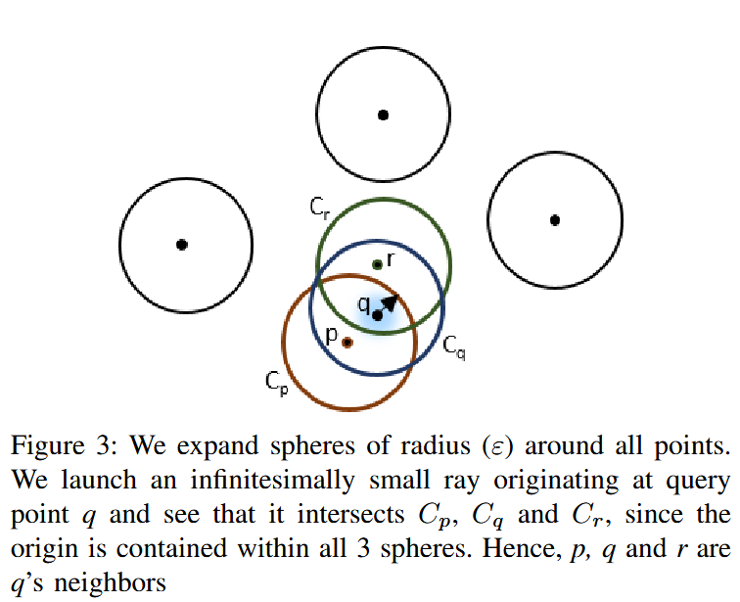
Literature review – RT-DBSCAN
Creative use of RT cores outside graphics purposes
Requires reframing of problem in terms of ray tracing concepts
Offers a performance advantage on larger datasets
Dimensionality limited to 3
Authors plead for more control and transparency of BVH structures and traversal
Figure from: V. Nagarajan and M. Kulkarni, "Accelerating DBSCAN using Ray Tracing Hardware," in 2023 IEEE International Parallel and Distributed Processing Symposium (IPDPS), St. Petersburg, Florida, 2023.
Notes:
Looking into the generality of applications using RT cores, perhaps one of the most creative uses is seen in RT-DBSCAN.
Here, the clustering algorithm is reimagined in terms of ray tracing concepts, by extending spheres around the points and using rays as point queries to determine neighbors of a point.
The solution offers an advantage on datasets with many datapoints, and the low dimensionality limit, which is otherwise tolerable in some problems, is argued to be manageable with dimensionality reduction methods
It is also to be noted that authors plead for more control and transparency of acceleration structures and their traversal.

Slide 15
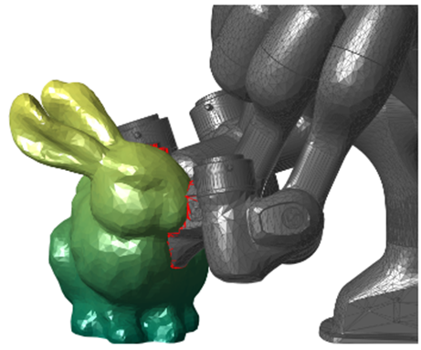
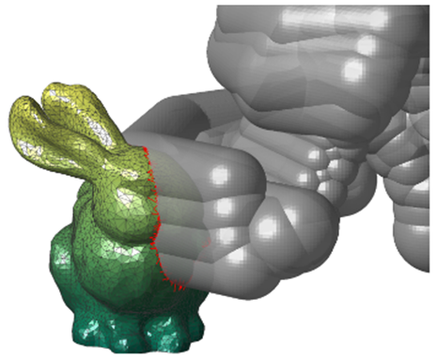
Literature review – Collision Detection
Multiple works presenting collision detection algorithms using hardware-accelerated ray tracing
Applications ranging from particles simulation in physics engines to discrete/continuous collision detection for robotics
Promising results in terms of performance
Criticism related to requirements for vendor-specific hardware platforms (NVIDIA OptiX and GPUs)
Figures from: S. Sui, L. Sentis and A. Bylard, Hardware-Accelerated Ray Tracing for Discrete and Continuous Collision Detection on GPUs, arXiv preprint arXiv:2409.09918, 2024.
Notes:
Another domain in which hardware-accelerated ray tracing was applied to is collision detection
Applications range from particle simulations to discrete or continuous collision detection along a robot’s planned trajectory
Performance results are encouraging across the works reviewed, but there is also concern related to the implementation based on NVIDIA OptiX, which may limit the choices for GPU devices.

Slide 16
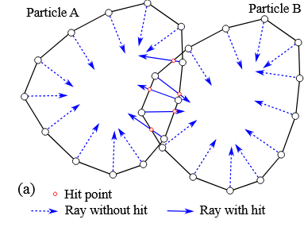
Literature review – Collision Detection
Collision detection using ray tracing was proposed ever since 2008 (Hermann)
Rays are cast from vertices opposite to their normal vectors (inwards) – do they hit another object’s inner face? => collision
RT cores and hardware-accelerated ray tracing bring such methods back into attention
Figure from: S. Zhao and J. Zhao, "Revolutionizing granular matter simulations by high-performance ray tracing discrete element method for arbitrarily-shaped particles," Computer Methods in Applied Mechanics and Engineering, vol. 416, no. 116370, 2023.
Notes:
Such methods of collision detection were proposed before hardware-acceleration for them existed, but this brings them into attention once more
Following a broad phase where potentially intersecting object pairs are selected from those with overlapping bounding boxes
These methods pertain to narrow phase, which are more precise, offer concrete contact points and hint towards resolution of such intersections
Rays are cast inwards from each vertex of the models, and if they happen to hit the interior of another object, a collision is detected.

Slide 17
Original approach – Motivation
The works in the literature that were reviewed all had implementations based off NVIDIA OptiX
Some do not use features that are proprietary to NVIDIA’s implementation of ray tracing, such as linear swept spheres – namely in collision detection
An approach based on Vulkan’s ray tracing extensions could help users select their preferred hardware platform, regardless of GPU vendor
It would also shift discussion of results from hardware limitations to performance and qualitative analysis
Notes:
The works reviewed so far used implementations in NVIDIA OptiX, but not all used proprietary NVIDIA features such as linear swept spheres.
An approach based on Vulkan’s ray tracing extensions could treat existing criticism by allowing the user to select their preferred hardware platform, regardless of GPU vendor
In doing so, it is intended that discussions regarding results could finally focus on performance and qualitative analysis

Slide 18
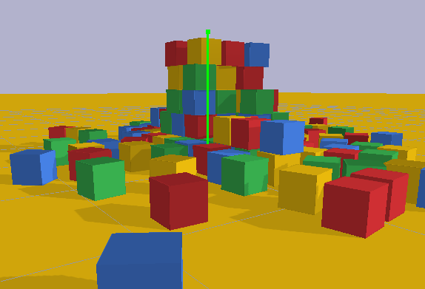
Original approach – Starting point
Starting from Bullet – open-source physics engine with rigid and soft bodies, joints, constraints, as well as other features
Existing OpenCL implementation of physics pipeline
Familiar decomposition in broad phase and narrow phase collision detection with similar acceleration structures
Notes:
Bullet is an open-source physics engine with rigid body simulation
It supports parallelization of the physics pipeline using OpenCL, and features familiar decomposition in broad phase and narrow phase collision detection with acceleration structures similar to those seen so far
These characteristics represent arguments for choosing Bullet as a starting point for the approach

Slide 19
Original approach – Potential directions
Broad phase collision detection – Bullet culls rigid body collision pairs by checking whether AABBs intersect. While Vulkan ray tracing also uses AABBs, acceleration structures are opaque and lack the functions of the software ones (such as intersections of AABBs). Implementations require both HW and SW structures
Narrow phase collision detection – demonstrated in literature
User ray casting – Physics engines allow users to cast rays for functionalities like visibility checks, distance or LiDAR sensor simulation, or even interaction with the scene in the form of object drag and dropping
Notes:
Going further, there are three potential directions
Replacing broad phase checks that rely on AABB intersection with structures used in Vulkan ray tracing. This is however not feasible because the standard describes those structures as opaque, meaning the programmer cannot access them directly or determine intersections between them, unlike the software ones. Thus, the implementation must use both hardware and software structures
Narrow phase collision detection was already demonstrated in literature
A use case not investigated is that of user ray casting, which allows users to cast rays with specified origins and directions for functionalities like visibility checks or distance sensor simulations

Slide 20
Implementation details
Setup
On convex shape registration – create GPU buffers for vertex and index data
When scene setup is done, build BLAS instances in bulk
For each rigid body, create a TLAS entry with the corresponding BLAS and transform data
Ray cast
Either on demand or with each step, copy transform data from GPU and update the TLAS
User rays are passed to a Vulkan kernel and a ray query is dispatched for each
Query results (object-space) are converted to world-space on CPU
Notes:
Presented here are the steps followed in the implementation
Starting with the scene setup,
When a convex shape is registered, create memory buffers on the GPU for vertex and index data
When scene setup is done, build BLAS instances in bulk
For each rigid body, create a TLAS entry with the corresponding BLAS and transform data Then, for each ray cast request
Either on demand or with each simulation step, copy transform data from GPU and update the TLAS
User rays are passed to the Vulkan kernel which dispatches ray queries
Results obtained in object-space are sent to CPU and converted to world-space using the available transform data

Slide 21
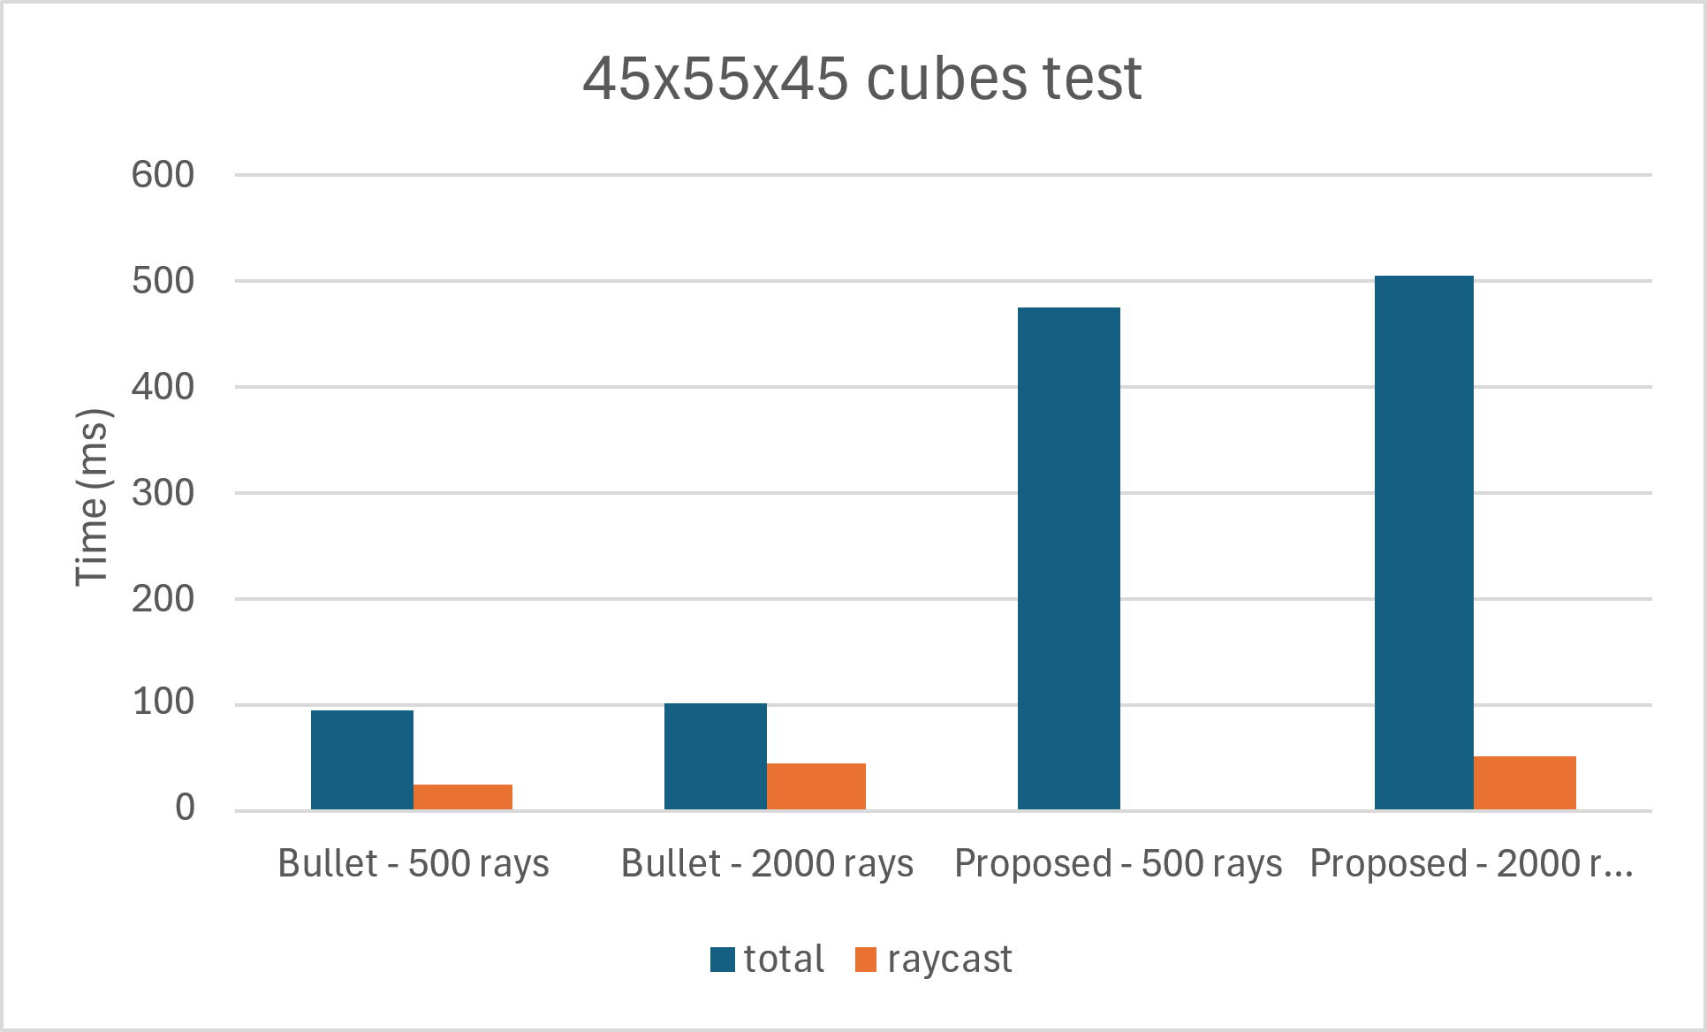
Results
Precision of time measurements (<1ms/frame, 50 frames) is a weakness in results
Results are comparable at a low object count, but not at scale
TLAS management aside, ray cast times are competitive and can be improved by addressing CPU bottleneck (availability of transform data)
This is while representing offload to RT cores
Bar chart of results – total includes setup and ray cast times, but the latter is presented separately for visual comparison
Notes:
Shown are the times for completion of 50 requests, with total time and that needed for ray cast shown separately
Measurement precision represents a weakness in the results as it does not seem to surpass millisecond scale
The results are not quite satisfactory at large scale, but focusing on ray cast time itself, they remain competitive while representing offload from compute shaders to RT cores

Slide 22
Conclusions
Performance of current implementation is not quite satisfactory – memory transfer bottleneck is caused by unavailability of transform data in the place that it is used – this can be improved by sharing buffers between APIs or using Vulkan all across
Still, the results shown encourage further pursuit of the approach because while the performance is comparable in some areas, it represents an effort offload from compute shaders to RT cores
Creative uses of RT cores outside graphics have been identified, as well as general information on their use and that of tensor cores
Standards are still open for extension and they could benefit by offering programmers more control and transparency

Slide 23

Thank you for your attention

